Slide 2
Nahum
“Who can endure the heat of His anger?”
Preaching Through The Prophets

Slide 3
Background of Nahum
Date
663-612 BC; roughly 625 BC
Audience
Written to Judah about Assyria
Theme
Destruction of Nineveh
Nahum 1:8, 15; 2:13; 3:15

Slide 4
Background of Assyria
Power and Cruelty
Sins of Assyria
Violence – Nahum 3:1; Jonah 3:8
Pride – Isaiah 10
Rebellion – Nahum 1:11; Isaiah 36-37

Slide 5
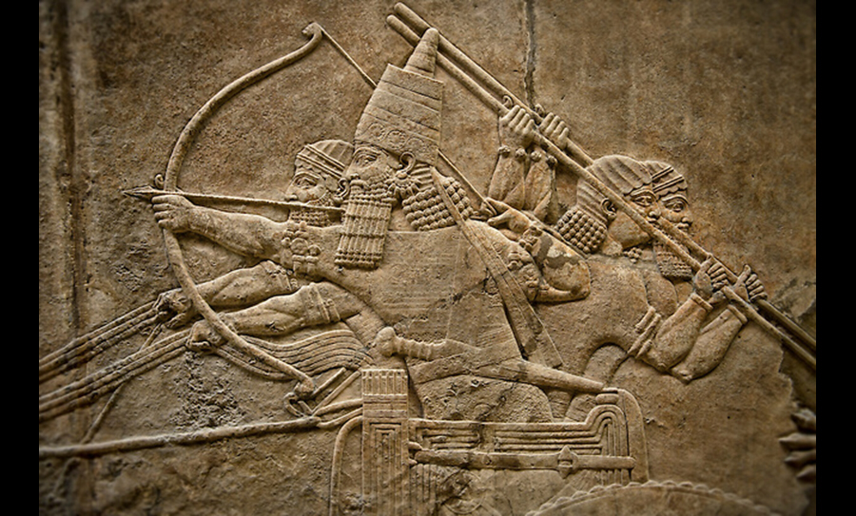

Slide 6
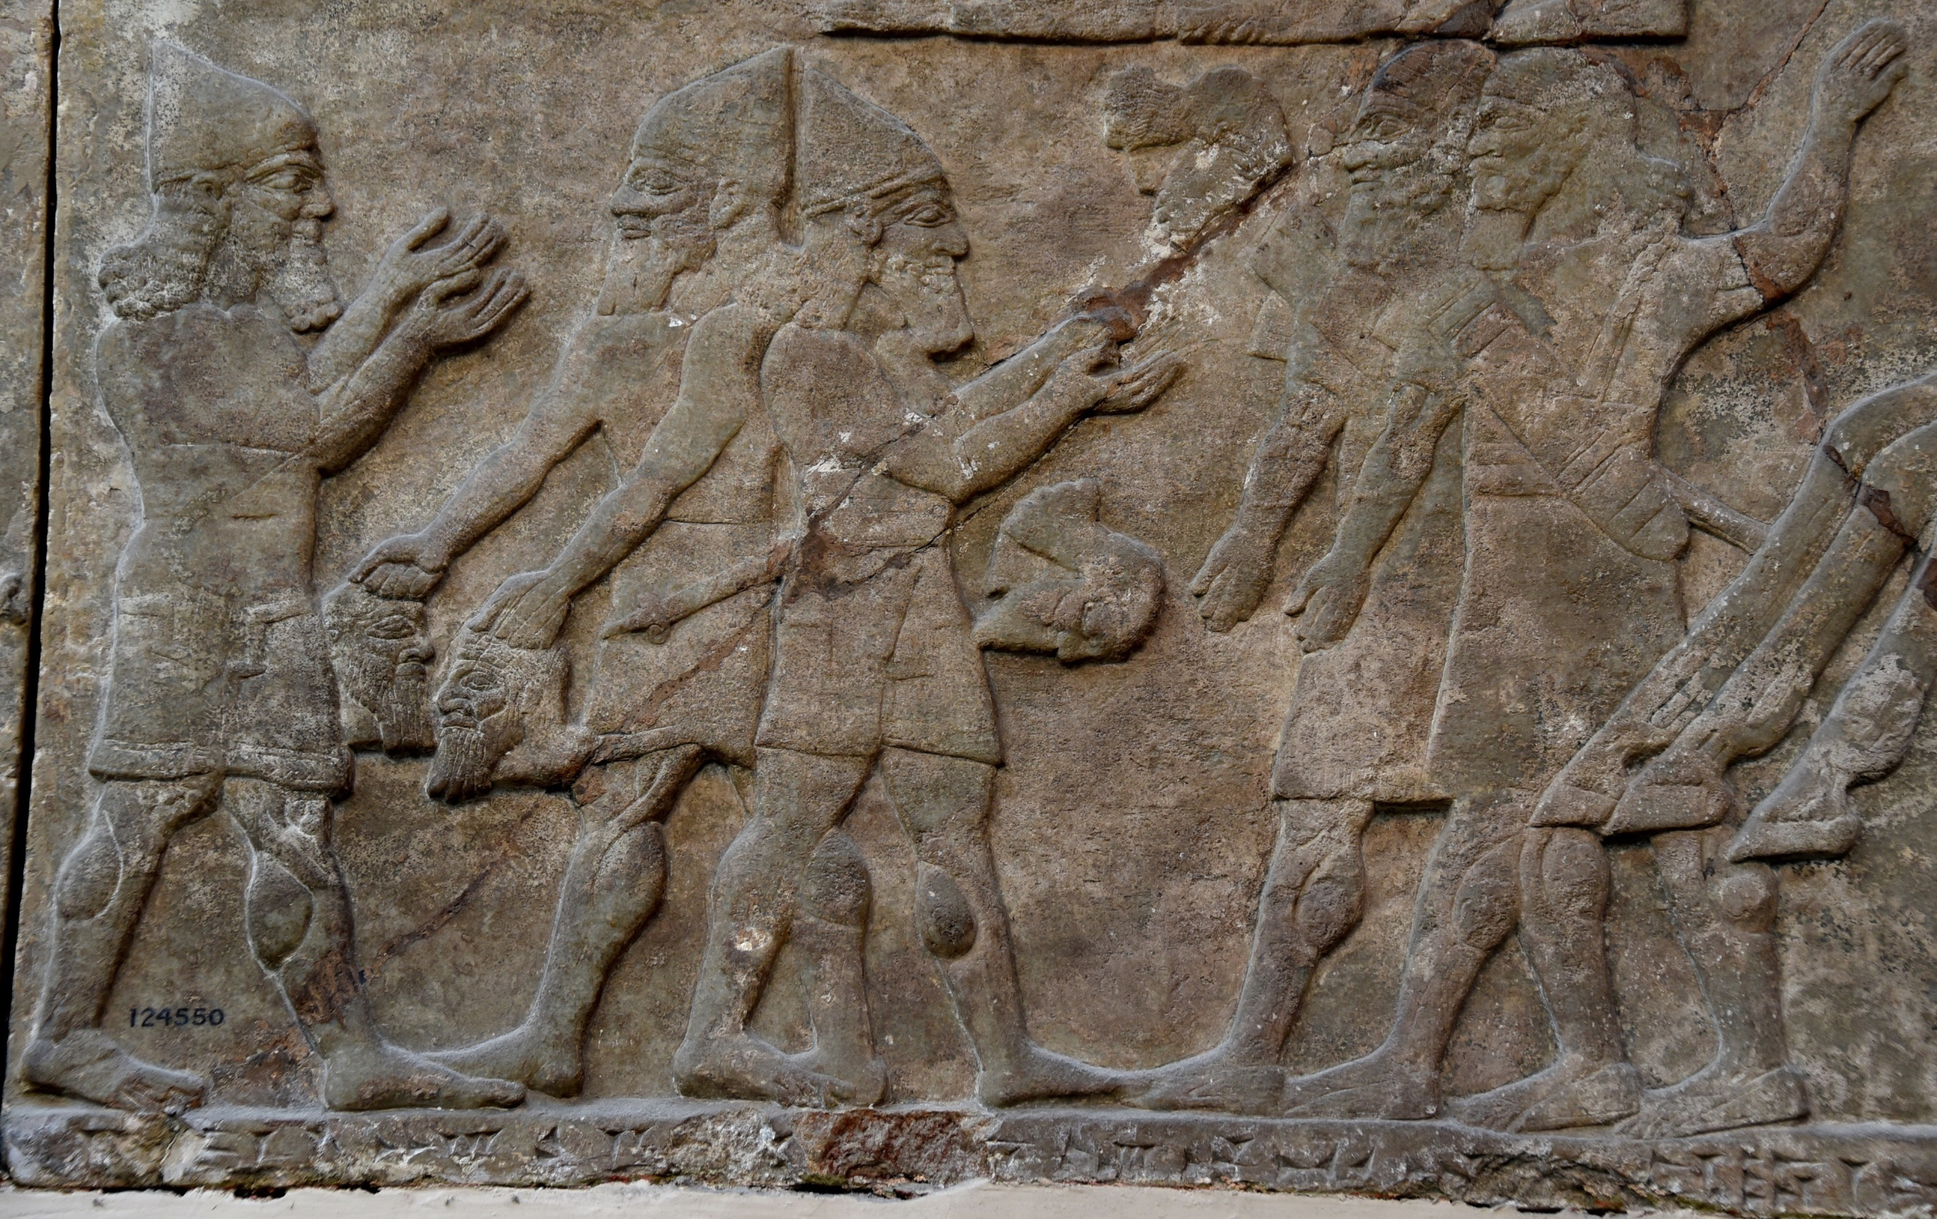

Slide 7
Background of Assyria
Power and Cruelty
Nahum 1:12

Slide 8
Background of Assyria
Destruction of Assyria foretold by Nahum
1:8; 2:6 – flood
1:14-15 – city would not be rebuilt
2:9 – looting
3:12 - fortress would fall
3:13-15 – city would be burnt
3:17 – leaders fleeing

Slide 9
Outline of Nahum
Nahum 1 – What God is about to do
Nahum 2 – How God is going to do it
Nahum 3 – Why God will do it

Slide 10
Nahum for Today
Who controls the nations of earth?
Nahum 1:12-13
Isaiah 10; 40
Nahum 2:8-10
Which side are you on?
Nahum 1:7-8
Romans 11:22

Slide 11
Nahum for Today
Who controls the nations of earth?
Which side are you on?
Will you be led astray?
Nahum 3:4
Isaiah 7:1-8

