Slide 1
Wives, Submit To Your Husbands

Slide 2
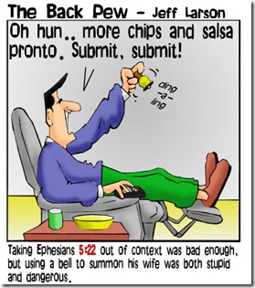

Slide 3
Wives are to be a “help meet.”
Genesis 2:18-23
1 Corinthians 11:8
1 Peter 3
1 Corinthians 7:16

Slide 4
Wives are to submit to their husbands.
Ephesians 5:22
Philippians 2:1-10
1 Peter 3:7
Galatians 3:26-28

Slide 5
Wives are to submit to their husbands.
Ephesians 5:21
Ephesians 5:22-23
Ephesians 5:24
Ephesians 6:1
Ephesians 6:5
Ephesians 6:9
Romans 13:1-2
Hebrews 13:17
Luke 2:51

Slide 6
Wives are to submit to their husbands.
1 Peter 3:1-6

Slide 7
Wives are to submit to their husbands.
Colossians 3:18
Matthew 20:25-28

Slide 8
Wives are to submit to their husbands.
Manner of submission: As to the Lord
Ephesians 5:22
Motive for submission: For the husband is the head
Ephesians 5:23
Acts 5:29
1 Peter 3:1
1 Corinthians 7:13

Slide 9
Wives are to love their husbands.
Love with obedience.
John 14:15
Genesis 18:6
1 Peter 3:6
Ephesians 5:33
Love with affection.
Titus 2:4

Slide 10
Wives are to love their husbands.
Love with obedience.
Love with affection.
Love with intimacy.
1 Corinthians 7:2-5

