Slide 2
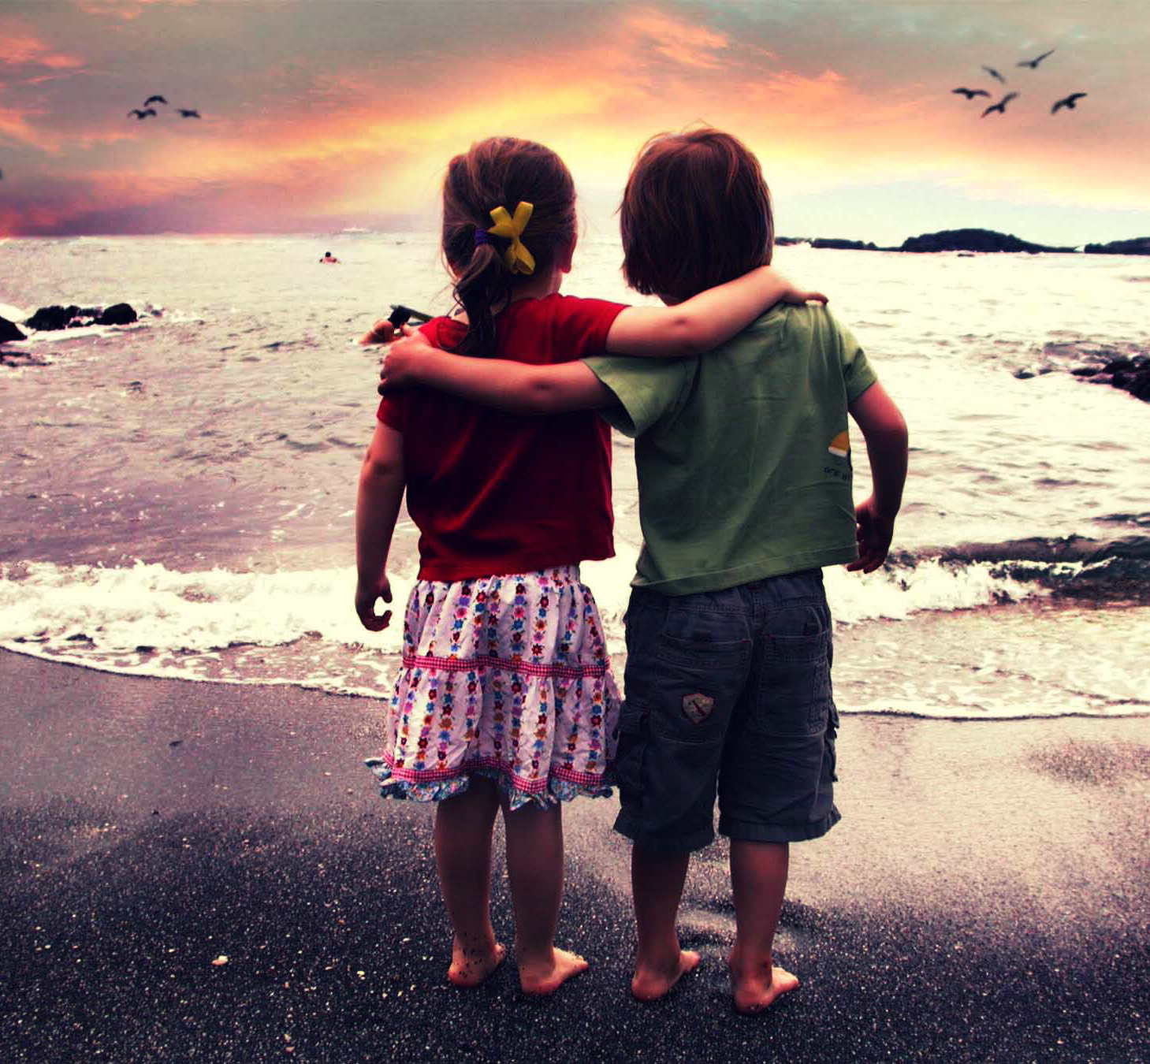
Act Like Children

Slide 3
Act Like Children
Children are obedient followers.
Matthew 19
Matthew 18:1-4
Children are faithful and trusting.
Isaiah 12:2
Proverbs 3:5-7
Proverbs 26:12

Slide 4
Act Like Children
Children are obedient followers.
Children are faithful and trusting.
Children are tenderhearted and forgiving.
Colossians 3:12-13; Ephesians 4:32
Matthew 18:21-22

Slide 5
Act Like Children Act Like Men

Slide 6
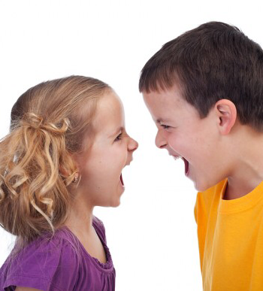
Act Like Children, Act Like Men
Men are not complainers.
Philippians 2:14-15
Men are not gossipers.
“A person who habitually reveals personal or sensational facts about others”
Romans 1:29; 2 Corinthians 12:20
1 Timothy 5:13

Slide 7
Act Like Children, Act Like Men
Men are not complainers.
Men are not gossipers.
Men are not envious and jealous.
Galatians 5:19-21
Proverbs 14:30
Acts 2:38

Slide 8
Act Like Children, Act Like Men
Men are not complainers.
Men are not gossipers.
Men are not envious and jealous.
Men are not arguers.
Proverbs 6:12-14,19
1 Peter 3:8-11
Romans 12:18

Slide 9
Act Like Children, Act Like Men
Men are not complainers.
Men are not gossipers.
Men are not envious and jealous.
Men are not arguers.
Men are not attention seekers.
Galatians 5:25-26
Proverbs 21:4
Philippians 2:3-5

