Slide 3
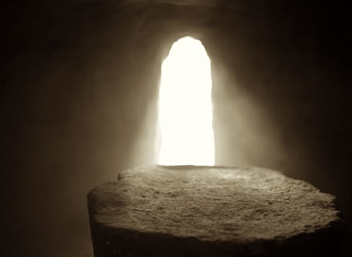
The Resurrection of Jesus Christ
Matthew 28
Mark 16
Luke 24
John 20-21

Slide 4
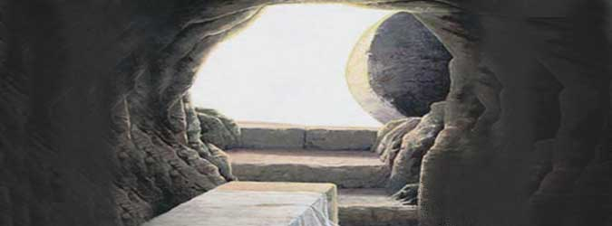
If Jesus Did Not Rise… 1 Corinthians 15:12-19
Our preaching is vain.
Our faith is vain.
Apostles were false witnesses.
We are still in our sins.
Believers have perished at death.
Christians are to be most pitied.

Slide 5
Christ Arose
1 Corinthians 15:20
Luke 24:18
Matthew 12:40; 16:21; 17:22-23; 20:17-19
Mark 8:31-9:1; 10:34
Luke 9:22-27; 24:6-8
John 2:19; 10:18; 12:16

Slide 6
The Resurrection and the Gospel
Peter preaching the resurrection
Acts 2:29-36; 3:15,26; 4:2,10; 7:56; 10:39-40
Paul preaching the resurrection
Antioch of Pisidia – Acts 13:29-38
Athens – Acts 17:3,30-31
Jerusalem – Acts 22:8
Sanhedrin – Acts 23:6
Before Agrippa – Acts 26:8
Romans 6:4-5

Slide 7
Significance of the Resurrection
Since Jesus raised from the dead, it verifies our justification.
Romans 4:24-25
Justification = “the act of pronouncing one righteous”
Matthew 26:28

Slide 8
Lessons From The Resurrection of Christ
Christ is the fulfillment of the Old Testament.
Luke 24:25-27
Luke 24:44-46; John 20:9

Slide 9
Resurrection in the Old Testament
1 Kgs 17:17-24
Elijah raises widow’s son.
2 Kgs 4:18-37
Elisha raises Shunammite’s son.
2 Kgs 13:20-21
Man thrown in Elisha’s tomb.
Hebrews 11:17-19
Abraham believed God.
Genesis 37; 40:15; 41:14
Joseph raised from the pit.

Slide 10
Resurrection in the Old Testament
Psalm 30:4-6; 86:13; 18:4-6
David delivered
Jonah 1:17; Matt 12:40
Sign of Jonah
Psalm 16:10; Acts 2:29-31
Fulfilled in Christ
Jeremiah 38; Daniel 3:22-24; Daniel 6; Psalm 2:7; Acts 13:33; Ezekiel 37

Slide 11
Lessons From The Resurrection of Christ
Christ is the fulfillment of the Old Testament.
With the resurrection, we have a living hope.
1 Peter 1:3
1 Peter 1:21
1 Corinthians 15:53-58

Slide 12
Lessons From The Resurrection of Christ
Christ is the fulfillment of the Old Testament.
With the resurrection, we have a living hope.
Christ’s life, death, burial and resurrection are in vain if you are lost.
1 Peter 2:21-25

