Slide 1
Offering Strange Fire to the Lord
God speaks to us through His Son, Heb. 1:1-2, Who speaks to us through His New Testament, 9:15-17.
Jesus, born under the Law, fulfilled the Law; it was nailed to cross. Gal. 4:4; Mt. 5:17-18; Col. 2:14.
Many Important Lessons to be learned from the O.T., Rom. 15:4; I Cor. 10:6,11.
One Lesson: We must not take unauthorized liberties with the word. One Example illustrating this: Nadab and Abihu,
Title: Offering Strange Fire to the Lord.
Text: Lev. 9:22-10:7.

Slide 2
Leviticus 9:22-24
V. 22. “And Aaron lifted up his hand toward the people and blessed them, and came down from offering of the sin offering, and the burnt offering, and peace offerings.
V. 23. And Moses and Aaron went into the tabernacle of the congregation, and came out, and blessed the people, and the glory of the Lord appeared unto all the people.
V. 24. And there came a fire out from before the Lord, and consumed upon the altar the burn offering and the fat: which when all the people saw, they shouted, and fell on their faces.

Slide 3
Leviticus 10:1-3
V. 1. “And Nadab and Abihu, the sons of Aaron, took either of them his censer, and put fire therein, and put incense thereon, and offered strange fire before the Lord, which he commanded them not.
V. 2. And there went out fire from the Lord, and devoured them, and they died before the Lord.
V. 3. then Moses said unto Aaron, this is that the Lord spake, saying, I will be sanctified in them that come nigh me, and before all the people, I will be glorified. And Aaron held his peace.

Slide 4
Leviticus 10:4-5
V. 4. “And Moses called Mishael and Elzaphan, and the sons of Uzziel the uncle of Aaron, and said unto them, Come near, carry your brethren from before the sanctuary out of the camp.
V. 5. So they went near, and carried them in their coats out of the camp, as Moses had said.

Slide 5
Leviticus 10:6-7
V. 6. “And Moses said unto Aaron and unto Eleazar and unto Ithamar, his sons, Uncover not your heads, neither rend your clothes, lest ye die, and lest wrath come upon all the people: but let your brethren, the whole house of Israel bewail the burning which the Lord hath kindled.
V. 7. And ye shall not go out from the door of the tabernacle of the congregation, lest ye die: for the anointing oil of the Lord is upon you. And they did according to the word of Moses.”

Slide 6
Background Information:
Aaron and his sons had been Consecrated as Priests, Lev. 8-9.
Aaron had just offered unto God “the sin offering, the burnt offering and peace offerings,” Lev. 9:22.
Then Aaron and Moses went into the tabernacle, then came out of the tabernacle and “blessed the people, and the glory of the Lord appeared unto all the people,” 9:23
Fire came from the Lord and consumed the offering, and the people shouted and fell upon their faces, 9:24.
A time of great rejoicing – but it will soon turn to sorrow!

Slide 7
Nadab & Abihu offered Strange Fire, 10:1-3.
Their Actions:
Took Censers, put fire in them, incense thereon, and offered to the Lord, Lev. 10:1.
The altar of incense in the holy place of tabernacle.
They “offered strange fire before the Lord which He commanded them not,” 10:1. “Unauthorized fire,” NIV and ESV.
The right people, the right place, the right censer, the right incense, but the wrong fire!

Slide 8
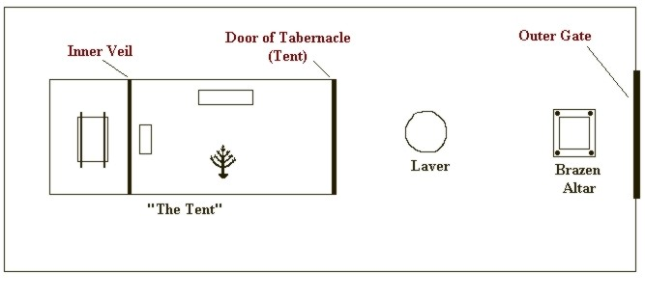
The Tabernacle

Slide 9
The Nature of the “Strange Fire:”
“Unauthorized,” NIV, ESV.
Taken from the wrong place!
Observe:
The brazen altar before the tabernacle.
Fire to burn continually in the altar, Lev. 6:12-13.
Fire for the burning of incense to be taken from the altar.
Regarding the offering of incense:
No “outsider” or one not a descendant of Aaron, Num. 16:40.
No “strange incense” to be offered, Ex. 30:7-9.
God even specified the formula for the incense, Ex. 30:34-37.

Slide 10
The Consequences of their Actions:
Fire went out from the Lord & devoured them! Lev. 10:2.
Note the contrast between the fires of Lev. 9:24 & 10:2.
They learned, the hard way, that “our God is a consuming fire,” Deut. 4:24; Heb. 12:28-29; Rom. 11:22.
Their cousins carried out their bodies, 10:4.
Family members forbidden to display any outward sign of mourning, 10:6
Further Instructions given in Lev. 10:9-10.

Slide 11
Lessons to be Learned from this Incident:
Those who worship God Must Regard Him as Holy, Lev. 10:2.
“I will be sanctified,” or “I must be regarded as holy,” NKJV.
“Holy” signifies “separation to God, the conduct befitting those who are separated,” Vine. I Cor. 1:30; 2 Thess. 2:13; I Pet. 1:2.
By offering that which was “unauthorized” Nadab and Abihu were not respecting the holiness of God.
Those who Worship God Must Glorify God!
“In them that come nigh me, and before the people I will be glorified,” Lev. 10:3.
We, too, must glorify God. I Cor. 10:31; I Pet. 4:16.

Slide 12
Lessons to be Learned (Con’t)
How We Worship God Makes a Difference!
What Nadab and Abihu did was done as an act of worship – but God was not pleased!
Their Sin? They offered “unauthorized” fire.
We should learn from their actions, Heb. 2:1-3.
Many today are still offering “strange fire!”
Changes in worship, organization, and work of the church,
Changes in “mode” of baptism, substituting man’s doctrines for the word, the Pope for Christ, Allah for God, etc., etc.
It seems that many have such a low view of God that they believe they can approach him in any way that pleases them!

Slide 13
Lessons to be Learned (con’t)
Service to God Must come before service to family! Lev. 10:6-7; Mt. 10:34-37;Lk. 14:26-27
God is Holy, Lev. 10:3; We must be Holy!
If we are to be holy, we must:
Leave sin behind, 2 Cor. 6:17-7:1.
Offer the kind of worship God has authorized, John 4:23-24.
Put God first in our lives, Matt. 6:33.

Slide 14
Conclusion:
From the Old Testament, we learn:
God was always pleased with those who did His will.
Always displeased with those who refused to do His will.
Blessed those who put Him first.
Punished those who refused to obey Him.
The Nature of God has not changed, Jas. 1:17.
There is no better time than right now to start serving God! 2 Cor. 6:2.

