Slide 1
Cisterns:
Artificial Reservoirs for storing Water.
Common in Bible lands and Bible days
Times when Cisterns were a blessing, 2 Chron. 26:9-10; 2 Kings 18:31.
But Cisterns also had Disadvantages!
“Cistern,” the word used in two senses:
Literally, s in 2 Kings 18:31.
Figuratively, as in Prov. 5:15-18; Jer. 2:13

Slide 2
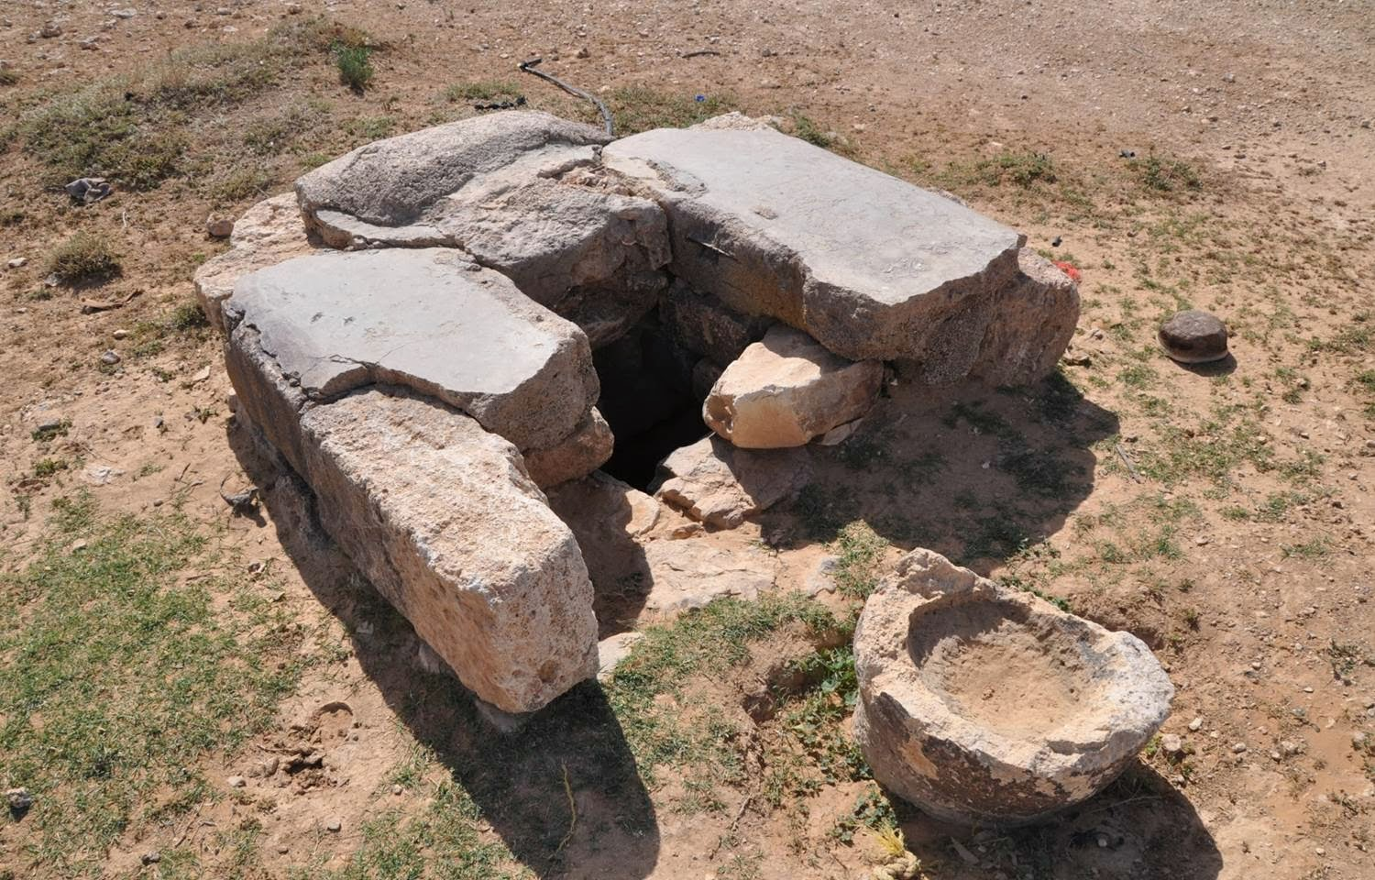
“Broken Cisterns that can Hold No Water”

Slide 3
Jeremiah 2:11-13
V. 11. “Hath a nation changed their gods, which are yet no gods? But my people have changed their glory for that which doth not profit.
V. 12. “Be astonished, O ye heavens, at this, and be horribly afraid, be ye very desolate, saith the Lord.
V. 13. “For My people have committed two evils; they have forsaken Me the fountain of living waters, and hewed them out cisterns, broken cisterns, that can hold no water.”

Slide 4
Background of the Text and Context:
Our Text describes the actions of Judah during the time of Jeremiah, a prophet.
Facts about Jeremiah:
“A broken hearted prophet with a heart-breaking message.”
From 13th year of Josiah to 11th year of Zedekiah.
He was highly sensitive, Jer. 9:1.
“He combines the tenderness of Hosea, the fear- lessness of Amos, the stern majesty of Isaiah.”

Slide 5
Consider the Times Politically:
After the division of the Kingdom, I Kings 12.
After the Assyrian Captivity, 2 Kings 17.
Before (and during) the Babylonian Captivity of Judah.
A time of political instability. Judah, reduced to a petty state, was caught in a death struggle between the Super powers, Egypt and Babylon.

Slide 6
The Times Morally and Spiritually:
Idolatry was rampant, Jer. 7:30-31.
The People were Backsliders, Jer. 8:5.
The people were guilty of murder, adultery, swearing, burning incense unto Baal, Jer. 7:9.
Deceit and Lying were common place, Jer. 9:3-6.
And their leaders were unconcerned! Jer. 10:21.

Slide 7
Examine the Text, Jer. 2:11-13.
“My People have changed their glory for that which does not profit,” v. 11.
Unlike the pagan nations which remained true to their gods, God’s people had forsaken Him, “and changed their glory for that which did not profit!
They had “committed two evils;” they had:
Forsaken “the Fountain of living waters,” and
“Hewed out cisterns, broken cisterns, that can hold no water,” v. 13.

Slide 8
Examine Text (con’t)
God was Israel’s “fountain of living waters,” He had:
Delivered Israel from the land of Egypt, Jer. 2:6.
Led them through the wilderness, Jer. 2:6, preserving them against all odds.
Had brought them into “a plentiful Country,” Jer. 2:7.

Slide 9
Even So, God’s People turned from Him!
The Priests did not say “where is the Lord,” Jer. 2:8.
Those who handled the Law did not know God, Jer. 2:8.
The pastors (rulers) transgressed against God.
The Prophets “prophesied by Baal,” Jer. 2:8
Summed up, they had:
Forsaken God, “the fountain of living waters,” 2:13.
Hewed out “broken cisterns that can hold no water.”

Slide 10
And they Suffered the Consequences!
Note Galatians 6:7.
They were carried away into Babylonian Captivity, 2 Kings 25; 2 Chron. 36; Jer. 52.
They had experienced God’s Goodness
But Now:
They would begin to experience His Severity, Romans 11:22!

Slide 11
Applications for Us:
Rom. 15:4; I Cor. 10:6, 10-12.
Jesus is our “Fountain of Living Waters,” John 4:9-10,13-14; 7:37-38; Zech. 13:1; 14:8.
This “fountain” was opened on the day of Pentecost, Acts 2:41,47.
The church Jesus said “I will build,” Mt. 16:18, came into existence; thousands were able to drink of the fountain of life as the terms of the gospel were proclaimed and promptly obeyed.
Gospel proclaimed to the world in one generation!

Slide 12
However!
Men began to “hew out broken cisterns,” Acts 20:28-30; 2 Thess. 2:3; I Tim. 4:1-3.
“Broken Cisterns” in the form of churches built by men, not by Jesus! Matt. 15:13.
“Broken Cisterns” in the form of false doctrines, 2 Pet. 2:1; I John 4:1; Mt. 7:15.
Some do not want the truth, 2 Thess. 2:10-12; I John 4:6.
A.T. Robertson in his Grammar of the Greek New Testament, there are “times when grammar must yield to theology.”

Slide 13
Other “Broken Cisterns”
Atheism! Psa. 14:1; Rom. 1:20.
Human Philosophy, Col. 2:8.
Other “broken cisterns,” such as:
Pleasure, Luke 8:14; Heb. 11:25.
Money, Luke 12:15; Matt. 16:26.
Immorality. Cf. Rom. 1:20-32.
A Chaplain summed up “broken cisterns” under the acronym, SAM, which stands for Sex, Alcohol, and Materialism.

Slide 14
We Must Turn from These “Broken Cisterns,” and Turn back to Jesus!
Jesus is that “fountain of living water,” John 4:10,14.
Jesus promises us that “water of life” that flows from the throne of God, Rev. 22:1.

Slide 15
Conclusion:
Israel had her “broken cisterns that could hold no water.” And they suffered the consequences!
Many today are hewing out to themselves “broken cisterns that can hold no water.”
Are we guilty of doing the same today?
We must turn from the “broken cisterns” of men and turn to that thirst-quenching “fountain of living waters,” Rev. 22:17.

