Slide 1
Overview of Revelation – an Introduction:
Revelation, the last book of Bible, very difficult, yet very important!
-- The 65 books which precede Revelation help
prepare us for its message.
-- Both Testaments find their fulfillment in it.
-- Paradise regained in the evening of time.
Revelation contains a blessing to those who “read,” “Hear,” and “Keep” its sayings, 1:3.
Yet a close study of Revelation is often neglected.

Slide 2
Introduction to Revelation – con’t
Its nature – “things signified,” Rev. 1:1
“The revelation (apokalupsis) of Jesus..,” 1:1.
  “Apokalupsis,” “an uncovering, Laying bare.”
  Apocalyptic language common in later years of Hebrew history.
  Apocalyptic language is figurative, but not typical figurative language, like Luke 13:32; John 15:5. Rather it is language in which real things are used to denote that which is unreal in nature.

Slide 3
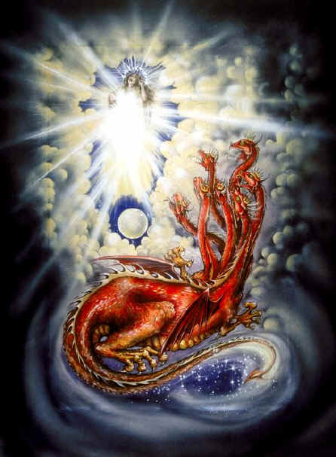
Example of Apocalytic Language

Slide 4
The Theme and Purpose of Revelation
Rev. 17:14: “These shall make war with the Lamb, and the Lamb shall overcome them: for He is Lord of lords, and King of kings: and they that are with Him are called and chosen and faithful.”
Christ is the great Victor and Conqueror: Rev. 1:18; 2:8; 11:15; 12:10-12, etc.
As Christ overcame, so can His followers: Rev. 2:7,11,17,26; 3:5,12,21, etc.

Slide 5
The Date for its Writing
Many believe it was written during the reign of Nero, before destruction of Jerusalem.
A greater number believe it was written during the persecution waged by Domitian, around A.D. 96.
The greater evidence, both historical and contextual tends to support the later date.

Slide 6
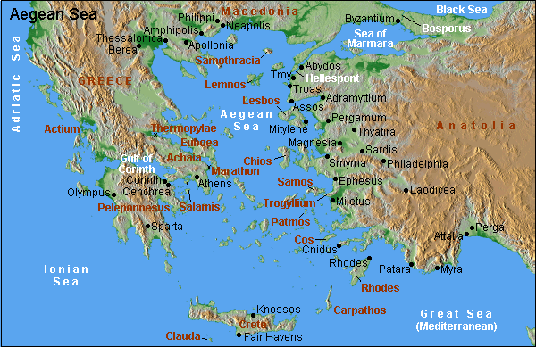
Written to the Seven Churches of Asia, Rev. 1:10-11

Slide 7
Methods of Interpretation
Historical View – that in symbolic form it outlines the entire course of religious history from Pentecost to the return of Christ.
  Including rise of Catholicism, Islam, Reformation.
Futurist View – dealing with events at the end of the world.
  1st three chapters applied to first century, or that the 7 churches represent 7 stages of history.
  And that chapters 4-19 relate to occurrences which will occur in about 7 years, called “the rapture.”

Slide 8
Methods of Interpretation, Con’t
Spiritual View -- only the presentation of great principles intended to guide and encourage followers of Christ.
Preterist View – holds that the symbols Revelation relate to events of the time in which it was written.
  Note: A combination of “Spiritual” and “Preterist” views harmonize with the teaching of the Bible in general, and would make Revelation meaningful to the Christians to whom it was written as well as Christians living today.

Slide 9
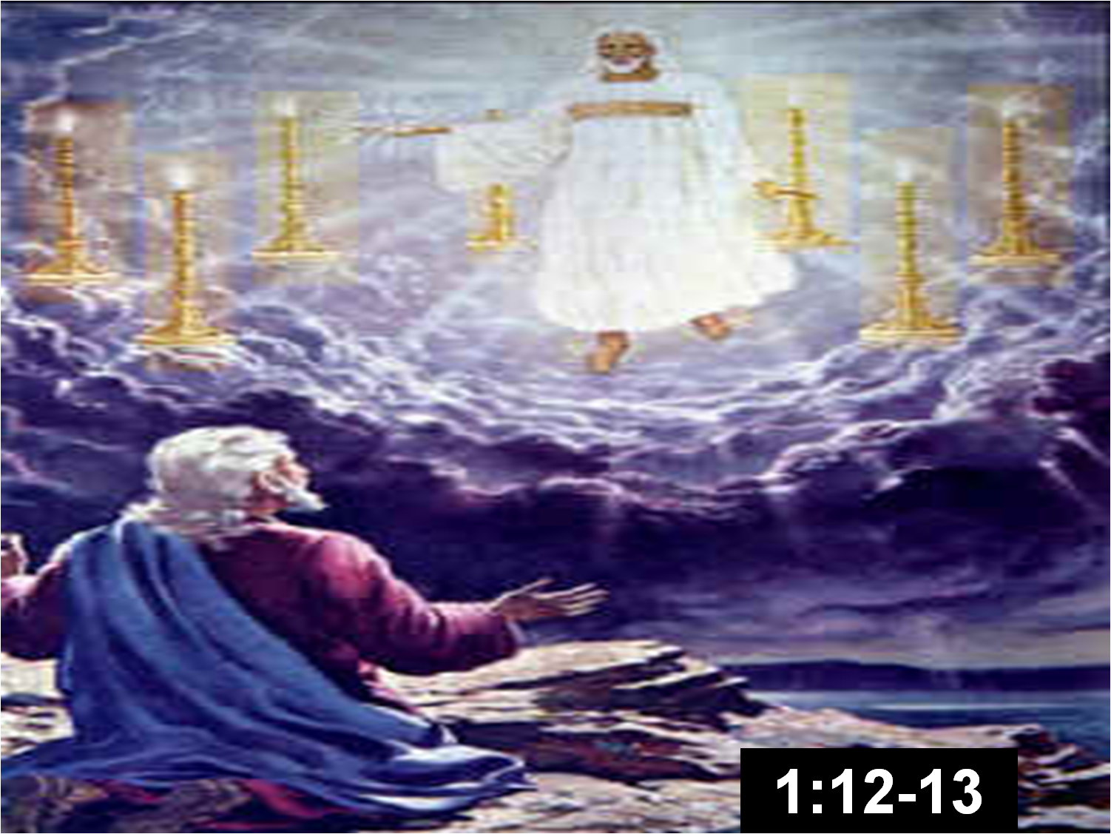
A Brief Outline of Revelation
Christ Amid the 7 Golden Candlesticks, Chapters 1-3

Slide 10
Outline of Revelation (con’t)
The Throne Scene and the Loosing of the Seven Seals, Rev. 4-7.
  God in glory on throne in heaven with book sealed with seven seals, Rev. 4:1-5:1.
  Christ “prevailed to open the book…” Rev. 5:5.
  The opening of six seals, chapter six.
  Ch. 7, The interlude between the 7th seal and the 7 trumpets. The saints (spiritual Israel) sealed for their protection in anticipation of destruction to come.
    A seal denotes ownership & approval, 2 Tim. 2:19!

Slide 11
Outline of Revelation (con’t)
The Sounding of the Seven Trumpets, Rev. 8-11.
The trumpets come after the seventh seal, as subordinate points in an outline.
The trumpets warned of partial judgments against the enemies of God’s people.
Chapter 12 – the woman, the dragon, and the man child (Christ).

Slide 12
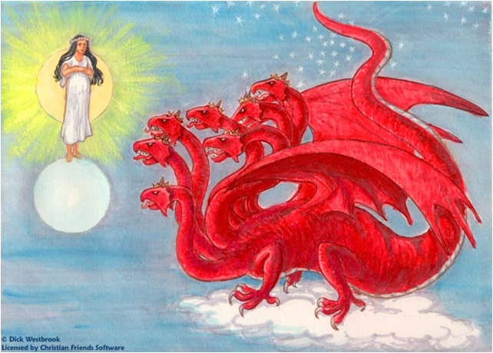
Outline (con’t) Chapter 12 – the dragon, the woman, & man child!

Slide 13
Outline – Chapter 13, The Two Beasts!
The Beast out of the Sea, Rev. 13:1-10; cf. Daniel 7.
  Having seven heads, 10 horns; upon his heads the names of blasphemy.
  The beast like a leopard, feet as the feet of a bear, mouth as the mouth of a lion; the dragon gave him his power, Rev. 13:1-2.
The Beast out of the Earth, Rev. 13:11-18.
  Later called “the false prophet,” Rev. 16:13; 19:20; 20:10.

Slide 14
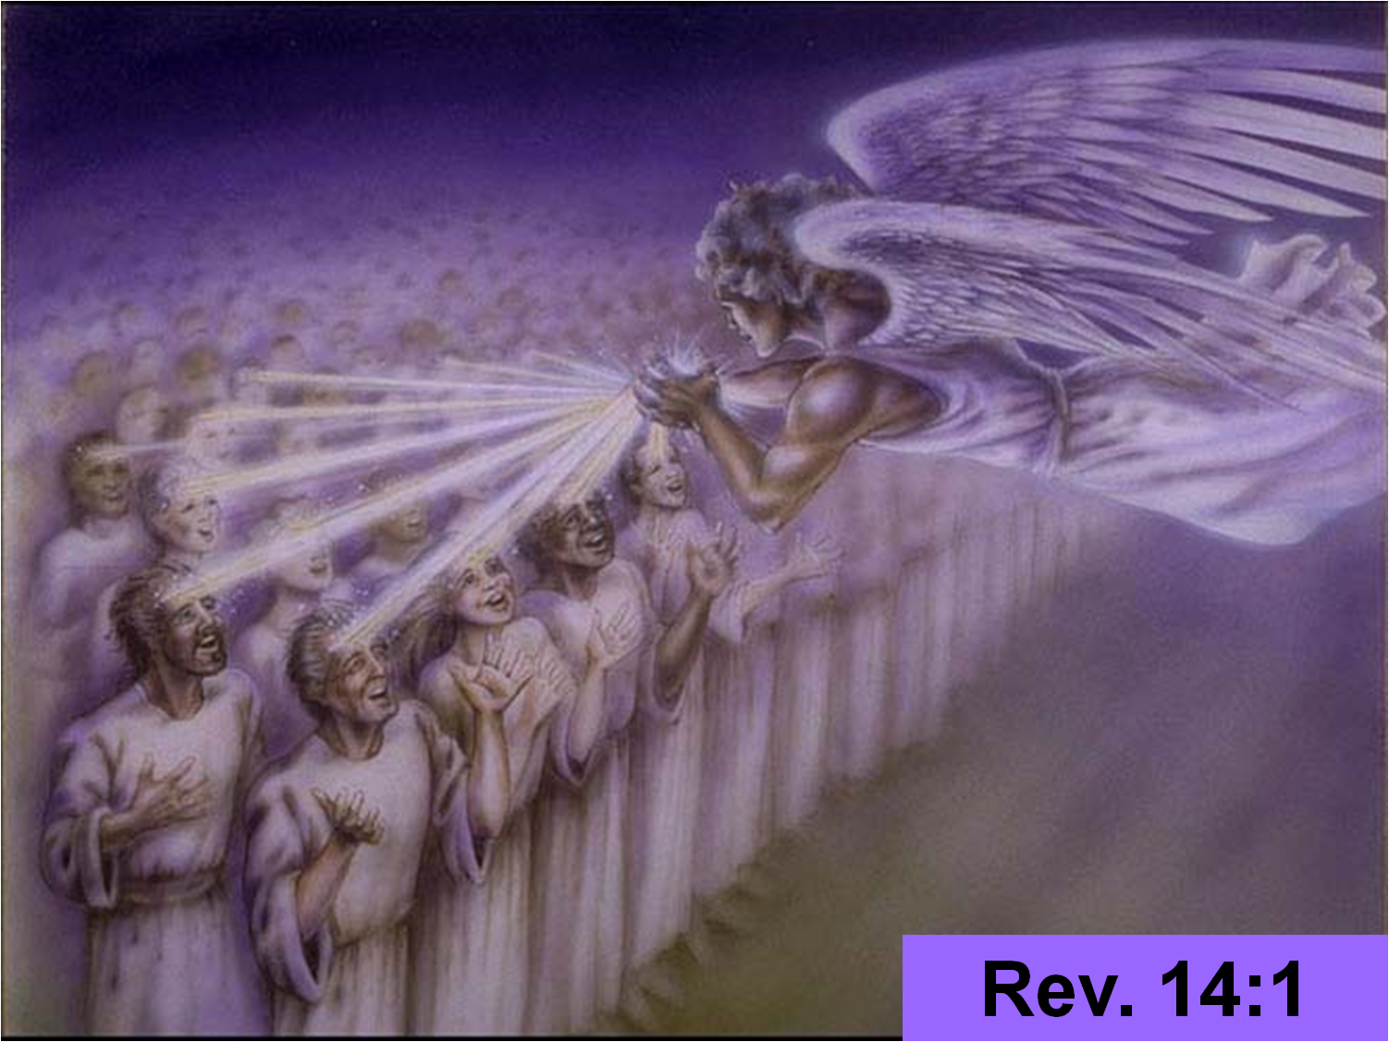
Outline – chapter 14, 144,000 singing a new song before the throne!

Slide 15
Outline – chapters 15-16
The Seven Bowls of Wrath
A Progression of thought:
  Seals, chapter 6, reveal.
  Trumpets, chapters 8-11, warn.
  Bowls of wrath, chapters 15-16, punish.

Slide 16
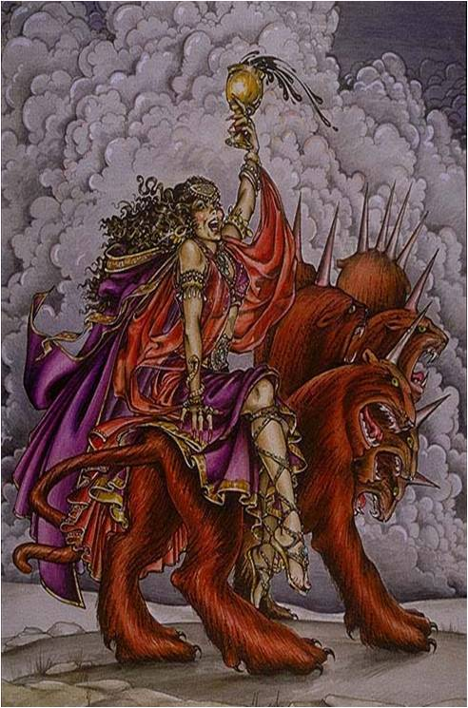
Outline, Chapter 17 (the great Harlot upon the Beast)!

Slide 17
Outline, Chapters 18-20
The Fall of the Great Enemies of God and His People!
Chapter 18, the fall of the harlot.
Chapter 19, the Judgment of the two beasts.
Chapter 20:1-10 The judgment of Satan

Slide 18
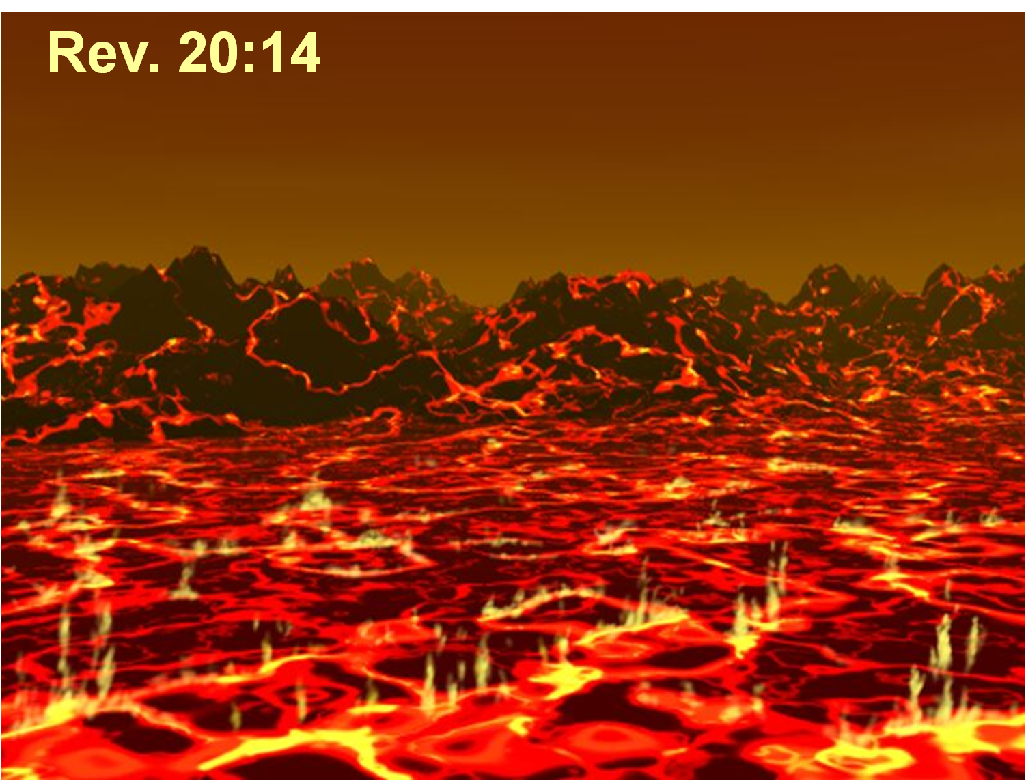
Outline, chapter 20, Destiny of Satan!

Slide 19
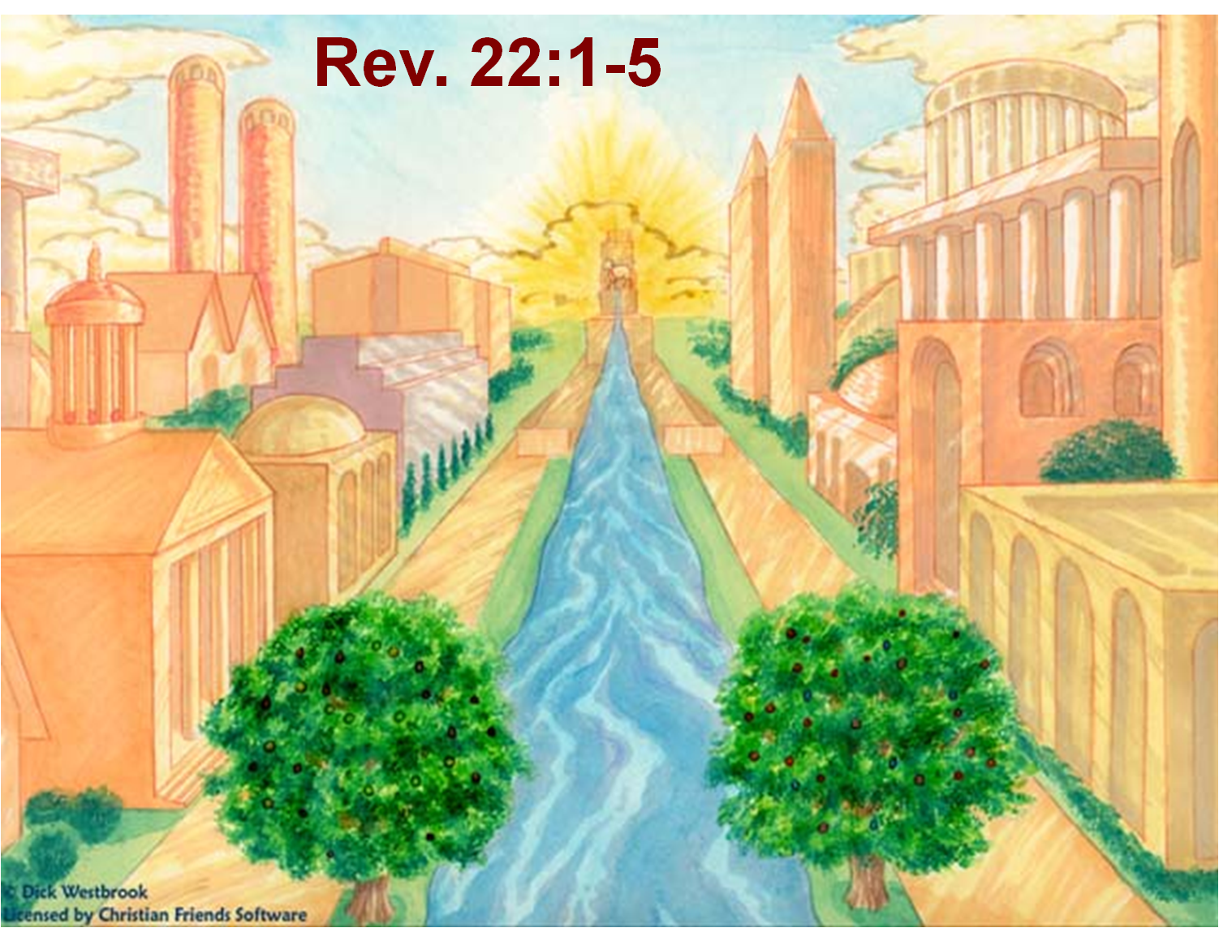
Outline, Chapters 21-22, The Glorious Destiny of the Redeemed

Slide 20
Lessons For Us
The Lord’s kingdom is in existence, Rev. 1:9.
Christ dwells among His people, Rev. 1:12-13, 20. cf. Matt. 28:20.
The Lord knows our works! Rev. 2:2,9,13,19; 3:1,8,15.
The Prayers of the Saints provide sweet odor for God! Rev. 5:8; 8:3-4.
Those who die “in the Lord” are “blessed,” Rev. 14:13. Consciousness survives death!

Slide 21
Lessons for Us (con’t)
Judgment day is coming! Rev. 20:12-15
  All the dead will stand before the Lord!
Man must not take liberties with the word of God, Rev. 22:18-19.
What was lost in Genesis is regained in Revelation!
  In Genesis 3:23 we see paradise lost; in Rev. 21-22 we see Paradise regained.
  In Genesis 3:24-24 we read of man cut off from the tree of life; in Rev. 22:2 access is again permitted to the tree of life!

Slide 22
Conclusion:
Properly understood, Revelation is perhaps the most encouraging book of the Bible for those who serve the Lord!
And the most scary book of the Bible for those in a lost condition.
The last chapter pronounces a blessing upon those who keep His commandments, v. 14.
And it issues an invitation for the lost to “come” and “take of the water of life freely,” v. 17.

