Slide 1
Preaching Through the Prophets
Series for 2018

Slide 2
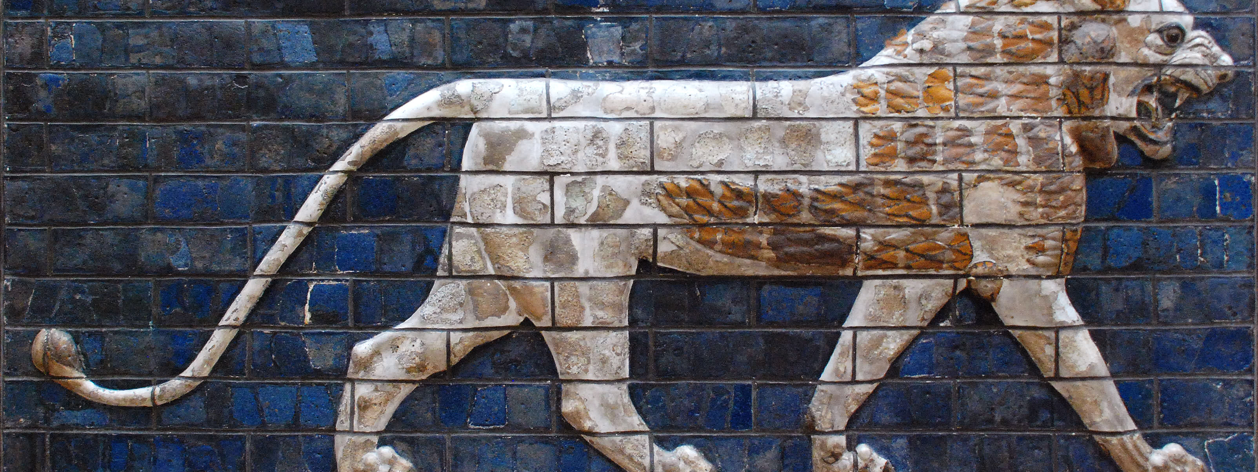
Daniel Joins The Real World
Preaching Through The Prophets

Slide 3
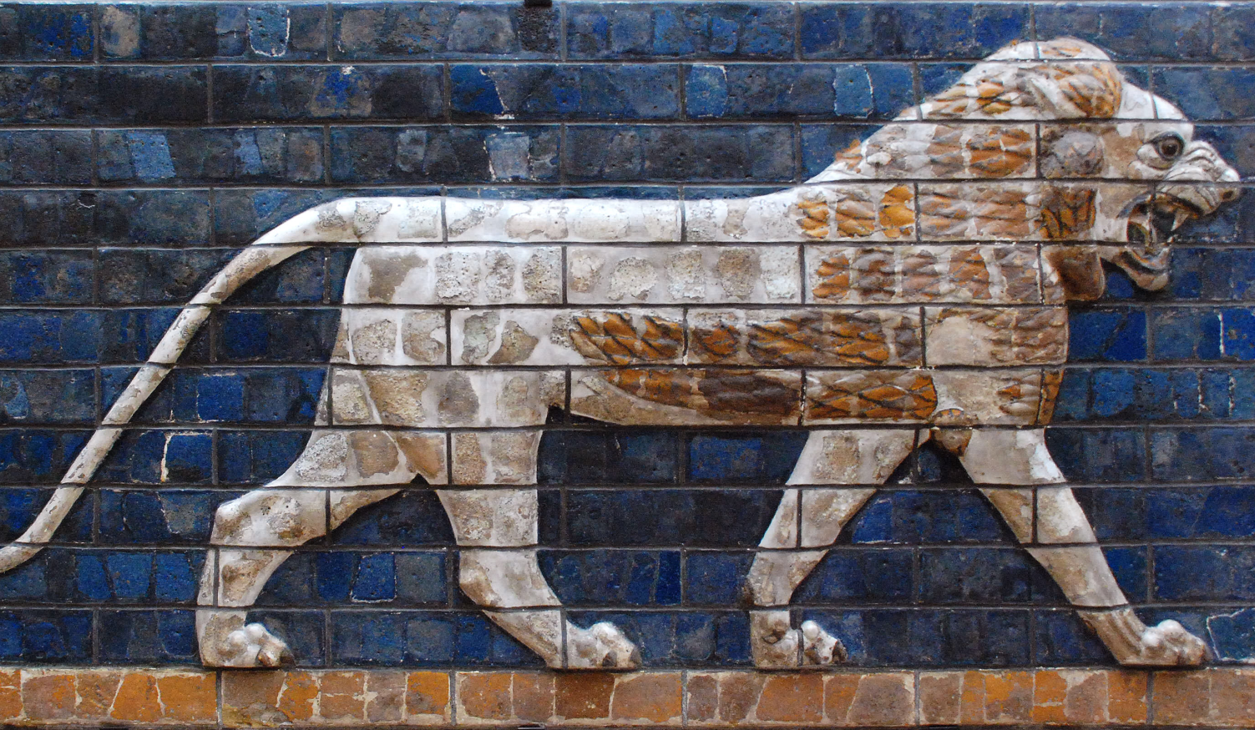
Daniel’s Environment Daniel 1:1-7
Young and on his own
Culture antagonistic toward God
Encouraged to give into temptations

Slide 4
How Daniel Survived
He found God-fearing companions.
He made up his mind to serve God.
He always remembered God.

