Slide 1
The Tabernacle and the Church
Book of Hebrews written to Hebrew Christians in danger of falling away.
“Better” a key word in Hebrews. 8:6; 1:4; 7:19; 10:34; 11:16,35; 12:24.
In this lesson we are drawing a contrast between two tabernacles – one which Moses built, and which Jesus built.
Text: Heb. 8:1-6.

Slide 2
Examine the Text:
Grand Summation –”we have such a high priest,” v. 1. cf. 2:17: 3:1; 4:14; 5:10; 6:20; 7:26; 9:11; 10:21.
Who is “seated at the right hand of the throne of the Majesty in the heavens,” v. 1.
“A minister of the sanctuary..”
And “of the true tabernacle,” which:
The Lord pitched and not man. Man built the tabernacle in Exodus; Jesus built the true tabernacle

Slide 3
Examine Text (con’t)
“Every high priest ordained to offer..,” v. 1.
“Of necessity that this man have somewhat also to offer,” v. 3; 7:27; John 1:29.
“If He were on earth..not be a priest,” v. 4.
The priests under the law served “unto the example & shadow of heavenly things,”v.5.
The Law, “a shadow of good things..,” 10:1,4;
Tabernacle foreshadowed the church, v.2.
Jesus “obtained a more excellent ministry.”

Slide 4
Important Facts About The Tabernacle and the Church
The Tabernacle had a divinely appointed builder; 8:5; Matt. 16:18.
Tabernacle had a divine purpose – where God dwelt among His people, Ex. 25:8; 29:45; Eph. 2:19-22.
The tabernacle built according to a divine pattern, Ex. 25:40; Heb. 8:5. The church must follow God’s divine pattern! Col. 3:17.

Slide 5
Specific Items Regarding the Tabernacle
Enclosed within the outer court. Ex. 27:9-17; 38:9-20. 100 by 50 cubits, Ex. 27:18.
Within the outer court, there existed:
The Brazen Altar, Ex. 27:1-8.
Where animal sacrifices were offered, Lev. 9:7.
Typical of sacrifice of Jesus, Heb. 13:10-12.
The Laver, Ex. 30:17-21.
Where priests washed b-4 entering tabernacle.
Typified baptism, Acts 2:38; I Cor. 12:13.

Slide 6
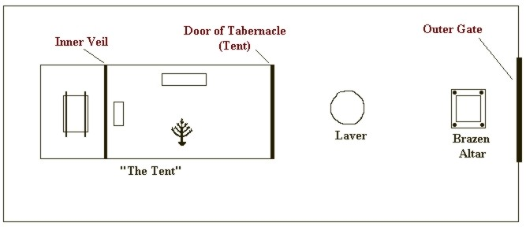
Outer Court and Tabernacle

Slide 7
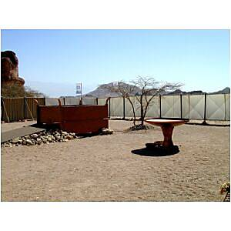
The Brazen Altar and Laver

Slide 8
The Tabernacle Itself
Consisted of the Holy Place (10 cubits by 20 cubits), Heb. 9:2 Ex.26:15-17.
Where priests went continually serve, Heb. 9:6.
Typified the church, I Pet. 2:5.
Consisted of the Most Holy place, Heb. 9:3; Ex. 26:33. (10 cubits by 10 by 10). A cube.
Into which the High Priest went alone every year, with blood of animals, Heb. 9:7.
Typical of heaven into which Jesus has entered,
Heb. 9:11-12,23-24; 7:25.

Slide 9
The Furnishings of the Holy Place, Heb. 9:1-2.
The Golden Candlestick, Ex. 25:11-39
Had seven branches, Ex. 25:31-32.
It burned continually, Lev. 24:1-4.
Fueled by pure olive oil, Ex. 27:20.
Furnished the only light, Lev. 24:1-4.
It typified (foreshadowed) Christ and the light of His word, John 1:1-9; John 8:12; Ps. 119:105,130; Acts 20:32.

Slide 10
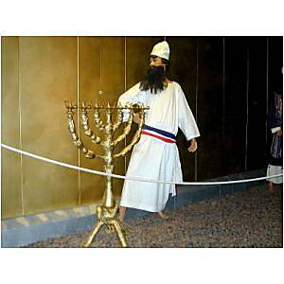
The Golden Candlestick

Slide 11
The Furnishings In the Holy Place (con’t)
The Table of Showbread, Ex. 25:23-30
Eaten by Aaron and sons in the holy place.
Typical of the Lord’s supper, Acts 20:7; I Cor. 11.
Partaken of by Christians, God’s priesthood, I Pet. 2:5
The Altar of Incense, Ex. 30:1-10.
Upon which incense burned as a “perpetual incense before the Lord,” v. 8
Typical of the prayers of the saints, Rev. 5:8; 8:3; I Thess. 5:17.

Slide 12
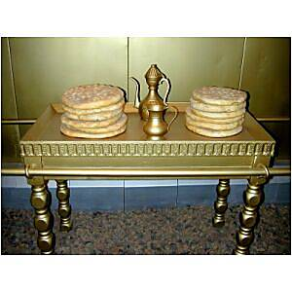
The Table of Showbread

Slide 13
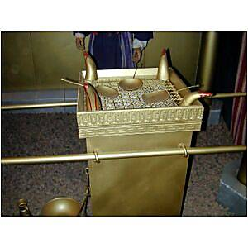
The Altar of Incense

Slide 14
The Furnishings of The Most Holy Place
The Ark of the Covenant, Ex. 25:10-15.
In which were tablets of stone, Ex. 25:16; Deut. 31:26, -- typical of God’s revelation, the New Covenant.
In which was the golden pot that had manna, Heb. 9:4. cf. John 6:48-51.
In which was Aaron’s rod that budded, Heb. 9:4; Num. 17:2-10; 2 Cor. 5:19-20.

Slide 15
The Furnishings of The Most Holy Place (con’t)
The Mercy Seat and the Cherubim.
Exodus 25:17-22.
Where God communed with the High Priest.
Typical of God’s throne of grace unto which Christians may come in time of need, Heb. 4:16.
Has been called “the meeting place of law and mercy.”

Slide 16
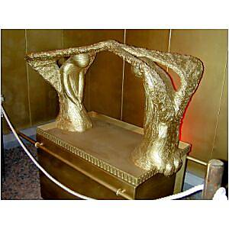
The Ark of the Covenant

Slide 17
Concluding Thoughts:
The holy place of the first tabernacle (Heb. 9:2) foreshadowed (Heb. 10:1) “the true tabernacle which the Lord pitched, 8:2.
A “pattern” was followed, Ex. 25:40; Heb. 2:2.
If the first tabernacle foreshadowed the church, then the church was not an after thought in the mind of God! Eph. 3:11.
To enter the most holy place (representative of heaven), one had to go through the holy place (representative of the church!)

