Slide 1
When Feelings Lead
Last Week: Facts, Faith, and Feelings.
Brief Review:
-Facts: “Something for which proof exists.”
- Faith defined: Heb. 11:1.
- Feelings: “A physical or emotional expereince or awareness.
Observe: proper feelings should result from faith, and correct faith must be based upon facts.

Slide 2
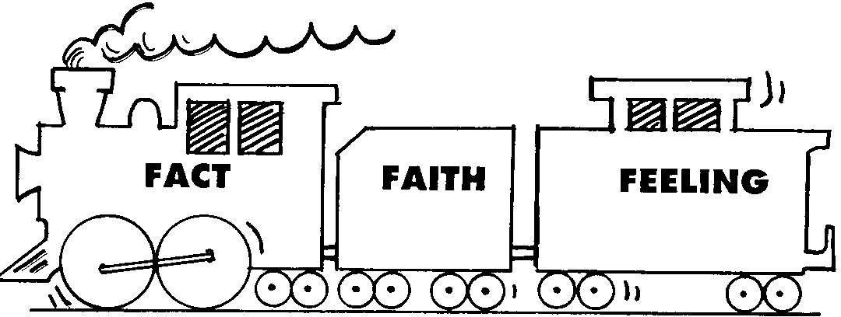
The Order Illustrated:

Slide 3
God Possesses Feelings or Emotions!
Grief, Genesis 6:5-6.
Wrath, Rom. 1:18.
Laughter, Ps. 2:4; 37:13.
Vengeance, Deut. 32:35; Rom. 12:19.
Hate, Prov. 6:19-20.
Pleasure, Isaiah 53:10.
Love, John 3:16.

Slide 4
Human Beings are Emotional Beings!
To be expected; we were created in the image of God, Gen. 1:26-27.
It is not wrong to have emotions or feelings; it is wrong to be led by, or to be controlled by our feelings, Eph. 4:26.
Jesus had strong feelings, but He controlled His emotions, Heb. 4:15; I Pet. 2:23.
Its fine to be emotional, but emotions must be controlled!

Slide 5
Many Bible Examples of People Who Sinned because of being led by Feelings!
Adam and Eve, led by love of world, Gen. 3:6.
Cain, motivated by anger, killed Abel, Gen. 4:4-8.
Abraham, influenced by fear, lied, Gen. 20:1-2,11.
David, motivated by lust, committed adultery, 2 Sam. 11:1-4; then had her husband killed, v. 14-15
Judas, influenced by greed, betrayed Jesus, Matt. 26:14-16.
Peter, moved by fear, denied Jesus, Matt. 26:69-75
Demas loved present world; forsook Paul, 2 Tim.
Diotrephes, loved preeminence…, 3 John 9.

Slide 6
Regarding the Ones Just Cited:
They all had a divine standard to follow (which if followed) would have prevented sin in their lives.
But each of them allowed feelings or emotions to lead them astray!

Slide 7
In Modern Times, influenced by feelings, Multitudes give way to sin! Jas. 1:13-15
Lust often leads to pre-marital sex, I Cor. 6:18; 2 Samuel 13:14.
Husbands and wives violating their wedding vows.
Many examples of murder and mayhem because of pent-up, uncontrolled anger, Eh. 4:26.
“Road rage” on Highways because of anger.
Robberies, fraud, theft, etc., because of greed and covetousness, Ex. 20:12; Eph. 5:5.
Political corruption because of greed and covetousness, Acts 26:27.

Slide 8
It is Not Wrong to be Emotional!
Jesus Possessed Strong Emotions.
He Wept, John 11:35; Luke 19:41; Heb. 5:7
He experience anger and grief, Mark 3:5.
He had compassion, Matt. 9:36.
Note: If Jesus was tempted in all points like as we are, Heb. 4:15, then He experienced every righteous emotion common to man!

Slide 9
Paul Possessed Strong Emotions!
Affection, Phil. 1:7-8.
Joy, Phil. 2:17.
Contentment, Phil. 4:11.
Heaviness or Sorrow, Rom. 9:2.
Etc.

Slide 10
It is Not Wrong to Be Emotional, or to Have Strong Feelings!
But it is wrong to be led by emotions (apart from facts and faith).
Prov. 14:12: “There is a way that seemeth right.., but it leads to death.”
Prov. 28:26: A man who trusts in his own heart “is a fool.”
Jer. 17:9: “the heart is deceitful above all things, and desperately wicked…”

Slide 11
Many Churches are More Driven by Emotions than Guided by the Bible!
In order to get an “emotional high,” they:
Build beautiful buildings, with crosses, stained glass windows, art work to “create a mood.”
Engage in certain rituals –lighting of candles, dimming lights, etc., to create a “special mood.”
Special music, involving singing groups, instrumental music, etc. for a “special mood.”
Have “personal testimonies, hand waving, clapping, etc. to create excitement and special “thrills,” feelings that “tingle the spine!”

Slide 12
In So Doing, they Ignore the Biblical Purpose of Worship, which is:
Honor and Praise God, Heb. 13:15.
Provoke one another to love and good works, Heb. 10:24-25.
Teach and admonish one another, Eph. 5:19.
Continue in “apostles’ doctrine,” Acts 2:42.
Worship God “in spirit and in truth,” John 4:24.
Edify one another, I Cor. 14:26.

Slide 13
Worship, Scripturally Engaged in, will Produce Wholesome Emotions!
Songs, ably led and sung “with the spirit and with the understanding,” I Cor. 14:15 produce strong emotions.
Prayers, wherein God is reverently addressed and petitioned, produce strong emotions.
Sermons which set forth the great love of God, and which describe the glories of heaven and the horrors of hell produce strong emotions.
Comments at the Lord’s table, and the proper observance of the L.S. produce strong emotions.

Slide 14
Conclusion:
It is not wrong to possess strong feelings. God, Christ, the Holy Spirit, and the Holy angels, all possess strong feelings.
But it wrong to be more led by emotions than directed by the Scriptures. If we learn to love what God loves and hate what He hates, our emotions will please God and benefit us.
If there are those in this assembly who have not obeyed the gospel, we hope you are experiencing the same emotions possessed by the Jews in Acts 2.

